Slide 1

Automotive Technology: A Systems Approach, 8e
Chapter 20: Lighting Systems
Rob Thompson and Jack Erjavec, Automotive Technology: A Systems Approach, 8th Edition. © 2025 Cengage. All Rights Reserved. May not be scanned, copied or duplicated, or posted to a publicly accessible website, in whole or in part.

Slide 2
Chapter Objectives (1 of 2)
20.01 Explain the operating principles of the various lighting systems.
20.02 Describe the different types of headlights and how they are controlled.
20.03 Explain the components and operation of automatic headlight systems.
20.04 Diagnose and repair headlight bulbs.

Slide 3
Chapter Objectives (2 of 2)
20.05 Understand the functions of turn, stop, back up, and hazard warning lights.
20.06 Diagnose and service exterior lights. Identify types of interior lights and their purposes.

Slide 4
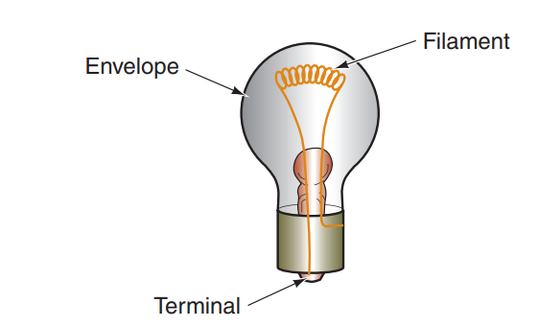
Automotive Lamps (1 of 5)
Perhaps, the most commonly used type of lamp today is the incandescent lamp, though these are being phased out and replaced by LEDs.
These lamps produce light when current passes through a filament made of tungsten.
The filament wire is heated to a high temperature, causing it to glow and give off light.
Electrical energy is changed to heat energy in the wire filament.
The filament is enclosed in a glass bulb that has been purged of air; therefore, the filament “burns” in a vacuum.
If air enters the bulb, the oxygen will allow the filament to oxidize and burn up.
As the filament burns, blackish deposits are left on the glass bulb. The presence of this coating is an indication that the bulb is bad or has little life remaining in it.

Slide 5
Automotive Lamps (2 of 5)
Halogen lamps are actually incandescent lamps.
This lamp comprises a tungsten filament enclosed in a halogen-filled bulb made of high-temperature resistant glass.
The name halogen is used to identify a group of chemically related nonmetallic elements, such as iodine, chlorine, and fluorine.
Most halogen lamps use iodine vapor.
These lamps provide brighter light because the filament is able to burn at higher temperatures, due to the presence of halogen in the bulb.
Another positive about a halogen lamp is that the filament does not break down, as it does in an incandescent bulb, due to the reaction of the burning tungsten and the halogen.
As a result, the metal vapor from burning is redeposited on the filament.

Slide 6
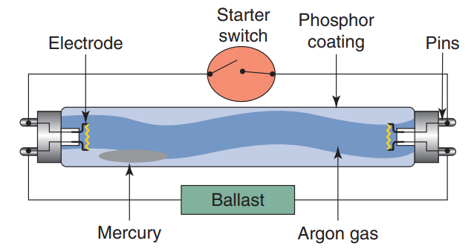
Automotive Lamps (3 of 5)
Like a neon lamp, a fluorescent lamp is a gas-discharge lamp.
The excited gas in the lamp is typically mercury vapor.
The enclosure of the lamp is coated with phosphor.
When current flows through the mercury vapor, the mercury atoms produce short-wave ultraviolet light causing the phosphor to fluoresce, providing visible light.
The advantage of using fluorescent lamps is they use less energy than a conventional incandescent lamp.
However, their initial cost is higher because they need an electric ballast assembly to regulate the current through the tube.

Slide 7
Automotive Lamps (4 of 5)
High-intensity discharge (HID) lamps provide more visible light, for the amount of consumed electrical power, compared to fluorescent and incandescent lamps.
Light is emitted when an electric arc jumps across the tungsten electrodes inside a clear or opaque tube filled with a gas and metal salts.
A ballast unit is required to start and maintain the arcing in a HID lamp.
There are many types of HID lamps including:
  Mercury-vapor lamps are commonly found in large parking lots or assembly halls. Like fluorescent lamps, they require a ballast to start. Older designs produced a bluish-green light, but the light from current versions has little color.
  Sodium-vapor lamps have two types: low pressure and high pressure. Both are rather energy efficient, and the high-pressure lamps provide a much whiter light.
  Metal-halide and ceramic-metal halide lamps can emit white light with lower cost and reduced noise than a mercury-vapor lamp.
  Xenon lamps are metal-halide lamps filled with xenon gas. Xenon gas gives off light almost immediately after arcing begins across the electrodes of the lamp.

Slide 8
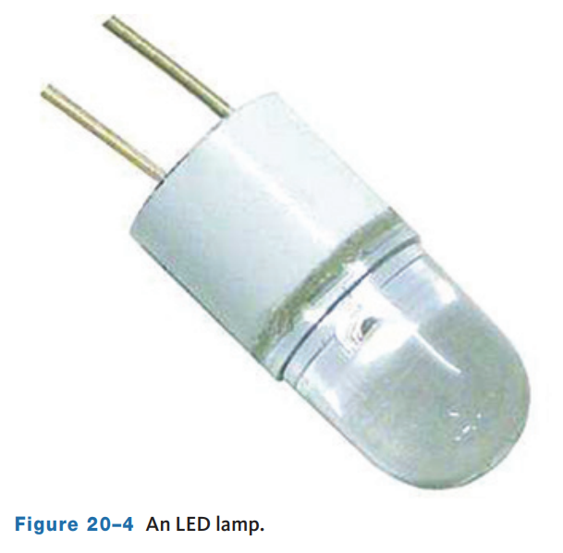
Automotive Lamps (5 of 5)
A light-emitting diode (LED) is a semiconductor that emits light when current passes through it.
LEDs also produce more light than heat and are much smaller than other types of amps.
The brightness of an LED depends on its temperature. More light is produced when the LED is operating with low current and is at a low temperature.
Also, in order for an LED to provide a constant light output, it needs to be powered by a constant-current power supply. The power supply helps keep the LED within the desirable temperature range.
Unlike other lamps, the bulb of an LED lamp does not put off much heat. However, heat is produced at the mounting base of the lamp assembly. That heat must be controlled to provide constant light and to protect the lamp.

Slide 9
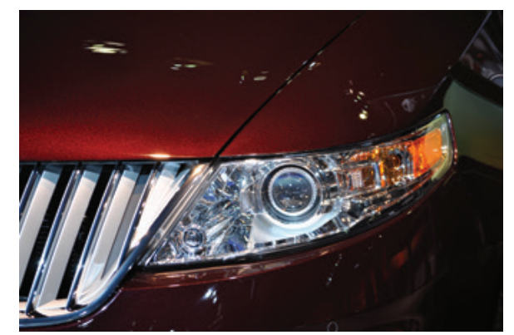
Headlights (1 of 4)
20.02 Describe the different types of headlights and how they are controlled.
A headlamp system must offer a low and a high beam.
The two beams on each side of the vehicle may have two separate lamps or a single lamp that can deliver both beams.
Low beams are intended to be used whenever other vehicles are in front of a vehicle or approaching it from the opposite direction.
Low beams are designed to provide adequate lighting in front of the vehicle with some light spread to the sides of that forward beam. But they are also set to minimize the amount of light that can shine in the eyes of other drivers, which can temporarily blind them.

Slide 10
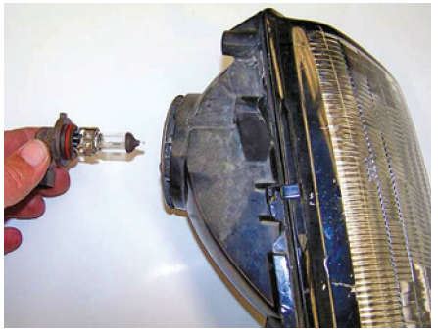
Headlights (2 of 4)
A halogen headlamp is a glass lamp filled with halogen that encloses a tungsten filament.
The tungsten-halogen combination, also called quartz-halogen, increases the light emitted by the tungsten filament.
In other words, a tungsten-halogen lamp emits more lumens than other lamps when the watts used to produce the light are considered.
As you may recall, a lumen is a simple measurement of the total amount of visible light a source emits.
A halogen sealed beam provides about 25 percent more lighting than conventional bulbs.

Slide 11
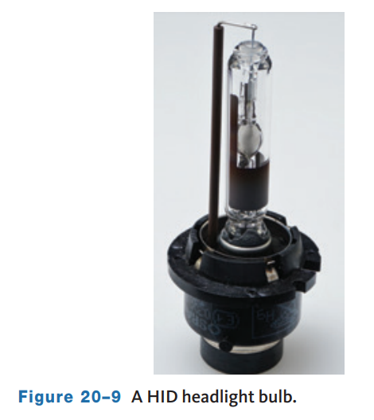
Headlights (3 of 4)
High-intensity discharge (HID) or xenon headlamps create light by creating and maintaining an electrical arc across two electrodes inside a bulb.
The arc excites the gas and salts inside the bulb which allows the arcing to continue to emit light.
These lights are recognizable by their slightly bluish light beams.
They emit this colored light because the inside of the bulb is filled with xenon gas mixed with mercury or bismuth. The result is a light that is much closer to natural daylight than that of other bulbs.
The lamps use AC voltage, and at least 30,000 volts are needed to jump the gap between the electrodes.
Once the voltage bridges the gap, only about 80 volts are needed to keep current flowing across the gap.
Each HID assembly includes a lamp, ballast unit, and starter (igniter). The igniter may be part of the bulb assembly or mounted externally.

Slide 12
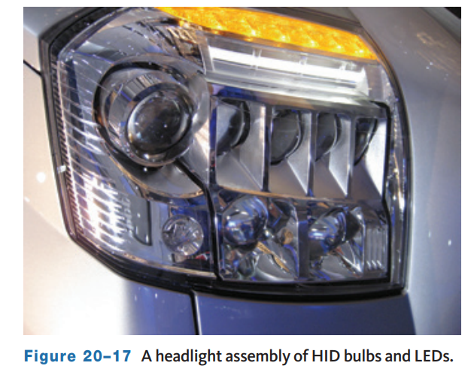
Headlights (4 of 4)
LED headlamps are standard on many vehicles today.
An individual LED does not produce enough light to serve as a headlamp, and ten to twenty LEDs are needed for ample forward lighting.
There are many reasons for using LEDs in headlights:
  LEDs do not require a vacuum bulb or high voltage to work.
  LED-based lighting sources require up to 40 percent less power than traditional lighting sources. This improves a vehicle’s fuel economy.
  LEDs provide a whiter light than xenon.
  LEDs are mercury-free, making them environment friendly unlike some HID/xenon systems.
  The average operating life of an LED is twice that of the vehicle itself.

Slide 13
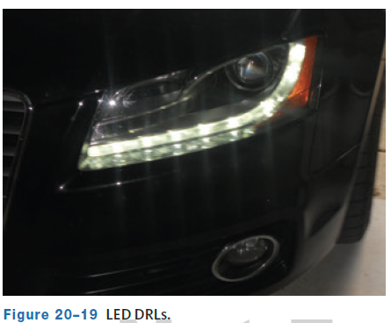
Daytime Running Lights
A large number of vehicles have daytime running lights (DRLs) for added safety.
This system typically uses the high-beam light circuit.
The control circuit is connected directly to the ignition switch to allow the lights to be turned on whenever the vehicle is running.
When the headlight switch is moved to the HEADLIGHT position, the DRL circuit is shut down and the headlights work with their normal intensity and brightness.
Applying the parking brake also deactivates the DRL system to make sure the lights are not on when the vehicle is parked with the engine running.
Many cars and light trucks now use LED daytime running lights.

Slide 14
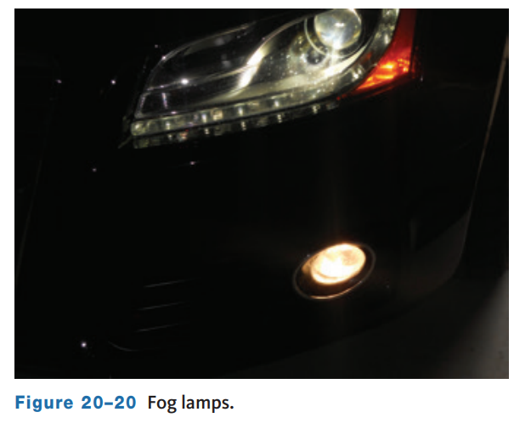
Fog Lights
Standard headlamps do not penetrate fog well.
When an intense beam of light hits some fog, all the driver often sees is a glare.
To provide some light through the fog, fog lights are designed to send a flat, wide beam of light under the blanket of fog.
This is why they are mounted low and are aimed low and parallel to the road.
A separate fog light switch is often incorporated into the headlight switch assembly, allowing both the low beam and fog lights to operate at the same time.
The fog light circuit turns off if the high-beam headlights are turned on.

Slide 15
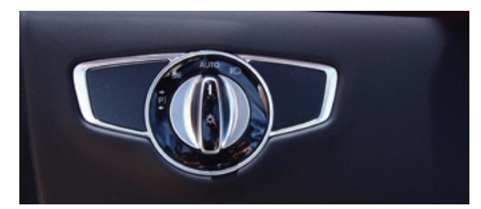
Headlight Switches (1 of 2)
20.03 Explain the components and operation of automatic headlight systems.
The headlights are controlled by a power or ground input.
Headlight switches are either mounted to the instrument panel or are part of the multifunction switch on the steering column.
Switches have three or four positions: off, park, headlight, and auto.
Most vehicles have a warning system that alerts the driver that the park or headlamps are on and that the driver’s door is open.
On older systems, the switch supplies battery voltage directly to the bulbs that have a fixed ground.
In many modern vehicles, the headlight switch is an input for the body control module (BCM) or lighting module.

Slide 16
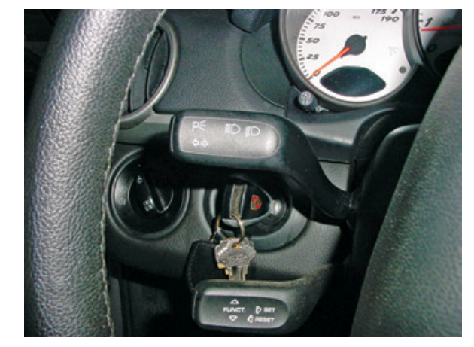
Headlight Switches (2 of 2)
The dimmer switch provides a way for the driver to switch between high and low beams.
A dimmer switch can act as an input request for the lighting module or can be in series with the headlight circuit and controls the path of current to the headlights.
Newer vehicles have the dimmer switch on the steering column as part of the turn signal switch.
When the headlight switch is in the HEADLIGHT position, current flows to the dimmer switch. If the dimmer switch is in the LOW position, current flows through the low-beam circuit.
When the dimmer switch is in the HIGH position, current flows to the high-beam circuit.

Slide 17
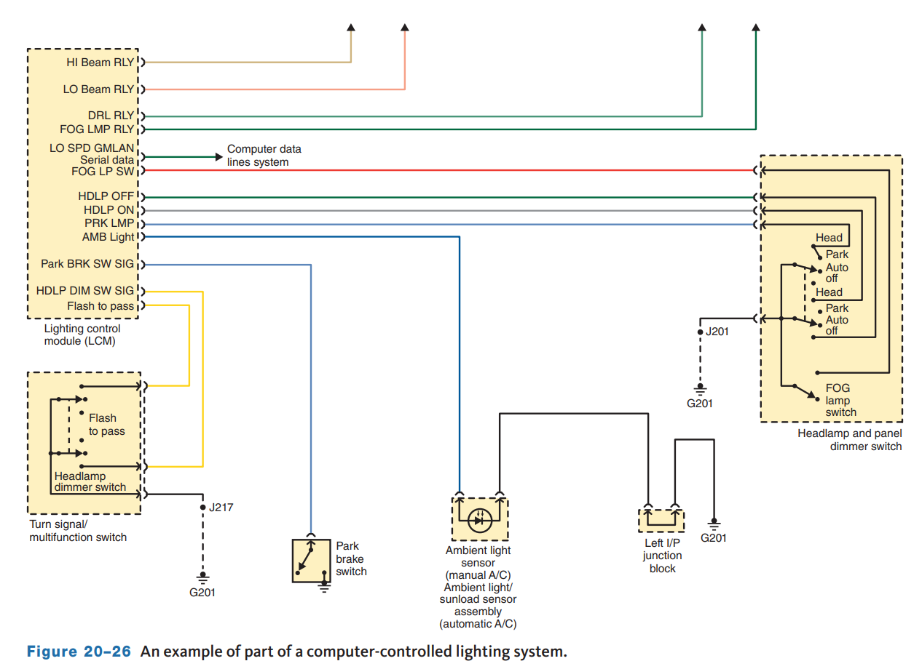
Automatic Light Systems (1 of 4)
20.03 Explain the components and operation of automatic headlight systems.
As with many other systems, exterior lights are controlled by electronic control modules.
This allows for automatic high-beam dimming, automatic on-off, glare-free high beam, headlamp leveling systems, directional headlamps, intelligent light systems, adaptive headlights, dynamic beam control, and advanced front-lighting systems.
Cameras and a variety of optical sensors have been added to these computer-controlled lighting systems.

Slide 18
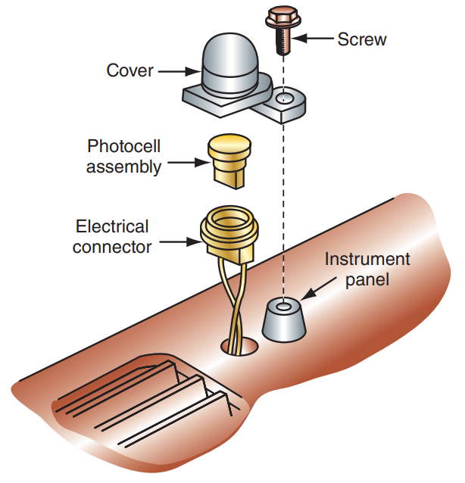
Automatic Light Systems (2 of 4)
Automatic headlamp systems automatically turn the headlights on when it becomes dark outside and turn them off when the natural light provides decent lighting.
An electric photocell located on the dashboard detects the current lighting conditions and activates the headlight control relay, which switches the headlamps on and off.
As the level of light decreases, the photocell’s resistance increases.
When resistance reaches a preset amount, the photocell’s s amplifier sends power to the headlight relay or module that controls lighting.
The lights will remain on until the system is turned off or the light outside gets bright enough.

Slide 19
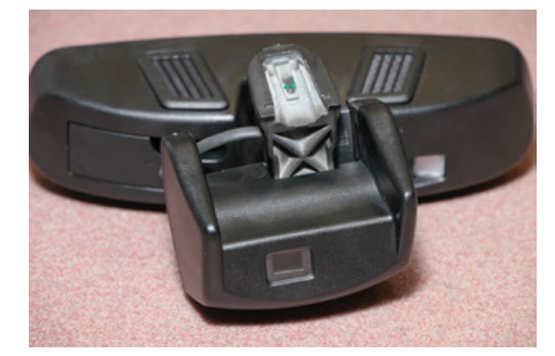
Automatic Light Systems (3 of 4)
Adaptive high-beam assist systems continuously adjust the lighting range of the headlamps so the beams only extend to the vehicle ahead.
Doing so allows for a maximum range of lighting without causing excessive glare in the eyes of other drivers.
These systems are offered by many manufacturers, and each calls the system by a different name.
Some have additional features in addition to the basic package. These systems provide for a continuously changing range of lighting.
There is no distinct transition from low to high beams. The intensity and aim of the lamps gradually change as conditions change.

Slide 20
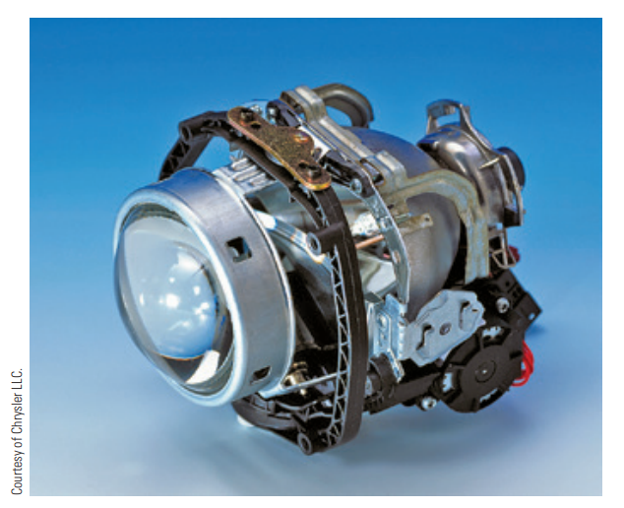
Automatic Light Systems (4 of 4)
Adaptive headlight systems (AHS) aim the headlight beams to follow the direction of the road directly ahead as the vehicle turns.
These systems are electronically controlled by a module and inputs from the steering angle sensor and vehicle speed.
Some vehicles have headlamps that are directly connected to the steering linkage to allow the lamps to follow the movement of the front wheels.
Today, systems rely on inputs from a variety of sensors and actuators to move the headlamps. Adaptive headlight systems are available on many vehicles, each with their own way to “bend” the light beams in anticipation of a turn.

Slide 21
Discussion
There are many different aspects of the automatic lighting system.
Have a class discussion while providing several examples of how automatic lighting systems can make the drivers life easier by requiring less input from the driver and more by the computer system. Provide several examples.

Slide 22
Headlight Service
20.04 Diagnose and repair headlight bulbs.
Many lenses are made of plastic (polycarbonate) and are affected by the environment and deteriorate.
The result is a cloudy lens that reduces the light of the lamps.
The cloudiness is caused by the oxidation of the lens’ protective coating installed by the lens’ manufacturer.
The lenses may also become pitted by road dirt and pebbles and can crack.
Cracks can allow water to enter the headlamp assembly and shorten its life.
There are many available products to restore the lenses. These may be special sanding pads or specially designed chemical compounds.
Most damaged headlamp covers will require wet sanding to remove the worst of the damage before a polishing compound is used on the lens.
Some restoration kits include a sealer to help prevent the lens from future damage.

Slide 23
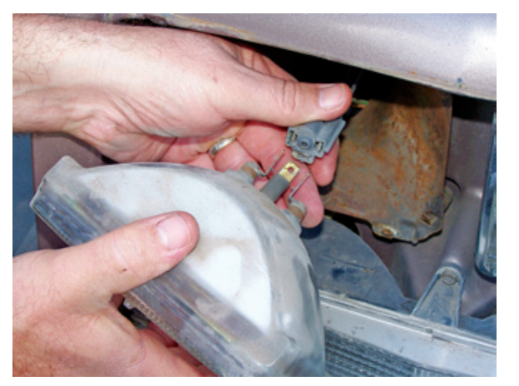
Headlight Replacement (1 of 4)
Sealed-Beam Headlight Replacement:
The lamp is normally secured with a bezel or ring.
This needs to be removed and the lamp pulled partially out of its housing.
Then disconnect the electrical connector from the back of the lamp.
Carefully inspect the connector for signs of damage or corrosion.
Some manufacturers recommend coating the prongs and base of a new headlamp with dielectric grease for corrosion protection.
Connect the new lamp to the electrical connector. Place the new lamp into the housing.
Position the lamp so the embossed number on its lens is at the top.

Slide 24
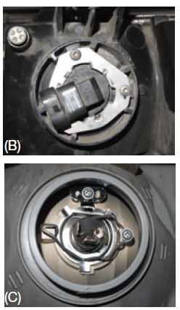
Headlight Replacement (2 of 4)
Composite Headlight Replacement:
Replacing a composite headlight bulb is typically very easy—getting to it often is not.
Bulbs are secured one of the three ways: with a retaining ring, by twisting and locking into the housing, or by a wire bale.
Before attempting to replace the bulb, refer to the service information for instructions.
If the bulb can be removed from the engine compartment, place a fender cover on the vehicle and remove any protective cover from the back of the housing and remove the bulb.
To access the bulbs in some vehicles, the bumper cover is removed to access the bolts that hold the headlight assembly, other bulbs are accessed through the fender liner.
When removing a bumper cover, you will probably have to replace the plastic body clips that are used to hold panels in place.

Slide 25
Headlight Replacement (3 of 4)
Proper diagnosis of these systems depends on understanding how the circuit works.
If only the low beams have an HID system, the headlights contain an arc tube and ballast.
The ballast increases the voltage so an arc can be established across the electrodes. When the headlight switch is moved to the HEADLIGHT position, the ground for the low-beam relay is completed by the control computer (BCM).
This energizes the relay, and battery voltage is applied to the ballast in each headlamp assembly.
The ballast increases the voltage and starts the high-voltage arcing to light the bulb. Once the arc is established, much less voltage is necessary to maintain the arc across the electrodes.
In bi-xenon systems, there is no separate high-beam bulb. Rather a solenoid or stepper motor attached to a shutter is used to redirect the light beams from the bulb. When the headlamp dimmer switch is moved to the high-beam position, ground is applied through the dimmer switch to the BCM.

Slide 26
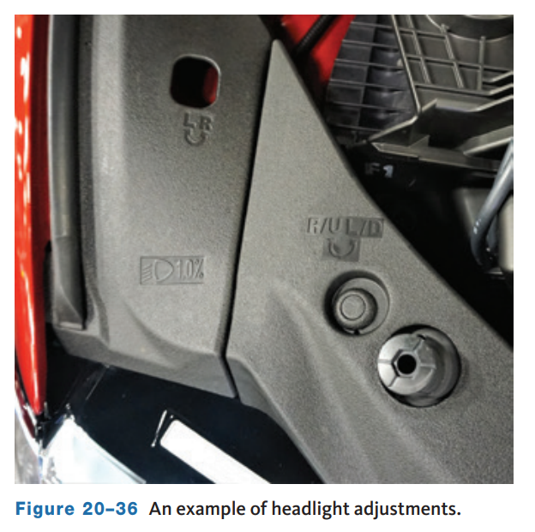
Headlight Replacement (4 of 4)
Headlights must be kept in adjustment to obtain the safest and best light beams on the road ahead.
Headlights that are out of adjustment can cause other drivers discomfort and sometimes create hazardous conditions.
Before adjusting or aiming a vehicle’s headlights, make the following inspections to ensure that the vehicle is level.
Any one of these conditions can result in an incorrect setting:
  Additional weight can alter the riding height.
  Try to make the adjustment with the fuel tank half full.
  Worn or broken suspension components affect the setting, so check the springs or shocks.

Slide 27
Knowledge Check (1 of 2)
Why is headlight aiming so important?

Slide 28
Knowledge Check Answer (1 of 2)
Answer: Headlights must be kept in adjustment to obtain the safest and best light beams on the road ahead.
Headlights that are out of adjustment can cause other drivers discomfort and sometimes create hazardous conditions.

Slide 29
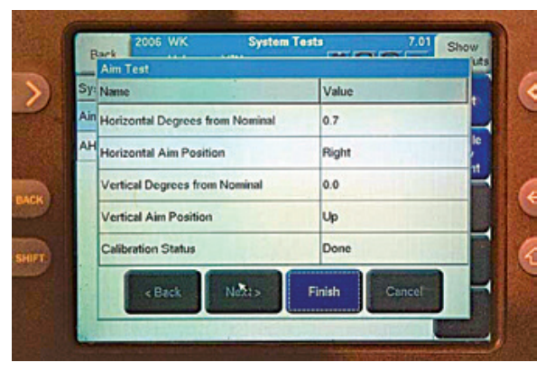
Automatic Headlight System Diagnosis
A photocell, normally in the vehicle’s dash, sends a signal to the BCM.
The BCM energizes the low-beam circuit when it is appropriate so if the low beams are not working when they should be, diagnosis will be necessary.
Each should be tested according to the procedures given by the manufacturer.
This involves many measurements and conducting tests with a scan tool.
Most systems also keep the lights on for a short time after the vehicle has been parked.
The controlling device for this feature is a potentiometer incorporated into the headlamp switch.

Slide 30
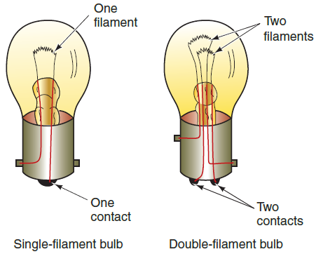
Basic Lighting System Diagnosis
Several types of light bulbs are used in today’s vehicles, and each has a unique purpose and a unique way that it fits into its socket.
Within a particular design, the different bulbs may have their own power rating.
When replacing a bulb, make sure it is the exact replacement.
Lamp types can be identified by the lamp’s standard trade number, usually present on the lamp’s housing.
Lamps are normally one of two types: they have a single filament or a double filament. Double-filament bulbs serve more than one function.
Light problems can be solved by simply replacing bulbs. A bulb can be quickly checked with a powered test light or an ohmmeter.

Slide 31
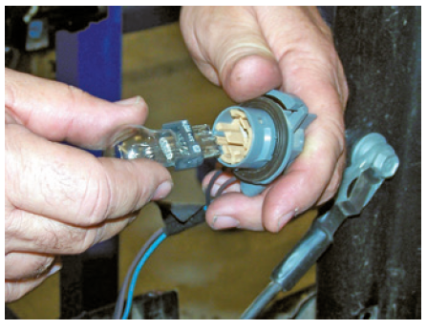
Bulb Replacement
Bulbs are held in their sockets in a number of ways. Some bulbs are simply pushed into and pulled out of their sockets, and some are screwed in and out.
Some bulbs must be depressed and turned counterclockwise to remove them.
When replacing a bulb, inspect the bulb socket. Often, moisture gets into a bulb socket and causes corrosion at the electrical contacts in the socket.
At times, the corrosion can be removed with sandpaper. Other times, the socket or light assembly should be replaced.
Light bulbs may be contained in an assembly, and access to the bulb is gained by reaching around the rear of the assembly and removing the socket.

Slide 32
Rear Exterior Lights (1 of 4)
Taillight Diagnostic Tips:
  If all lamps don’t operate, check the condition of the fuse.
  If the fuse is good, check the operation of the taillight relay.
  You can use a test light or voltmeter to check for the presence of voltage and ground at various parts of the circuit at the relay.
  If the system uses a BCM or lighting module, check for light switch input with a scan tool.
  If no voltage is measured at one of the circuits, there is probably an open in that circuit.
  If no voltage is reaching the taillights but the headlamps are working fine, the problem may be the headlight switch or the wiring to the rear of vehicle.

Slide 33
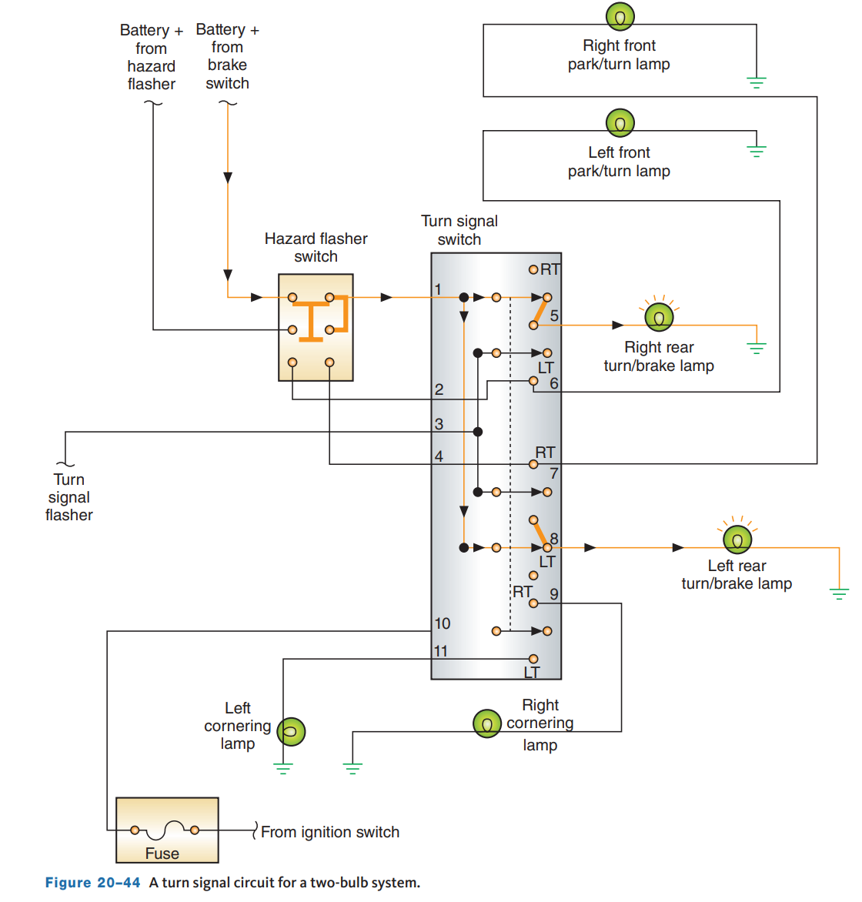
Rear Exterior Lights (2 of 4)
20.05 Understand the functions of turn, stop, back up, and hazard warning lights.
Each system has a switch that must close to turn on the lights in the circuit.
The hazard lights are also powered through the fuse panel; however, they have power at all times regardless of ignition switch position.
Hazard lights are commonly referred to as four-way flashers because the lights at all four corners of the vehicle will flash when the circuit is turned on.
Side markers are connected in parallel with the feed circuit (from the headlight switch) for the filaments of the front parking lights and rear taillights.
The turn signal and hazard light switches on many current vehicles are part of a multifunction switch.

Slide 34
Rear Exterior Lights (3 of 4)
Occasionally, the flasher does not flash as fast as it once did, or it flashes faster. This is also cause for replacement.
If it flashes too slowly or not at all, check for a burned-out bulb first. However, keep in mind the flasher rate is affected by the type of flasher.
Flashers are designed to operate a specific number of bulbs to give a specific candlepower (brightness).
Newer vehicles may have a combination flasher unit that controls the flash rate of both the turn signals and the hazard lights. These combination flashers are electronic units. The actual turning off and on of the lights is caused by the cycling of a transistor.
This type of flasher also senses when a bulb is burned out and causes the remaining bulbs on that side to flash faster.
Because this flasher is an electronic device, it cannot be tested with normal test equipment.
The only test of the flasher is to substitute it with a known good one. If the lights flash normally, the original flasher unit was bad and needs to be replaced.

Slide 35
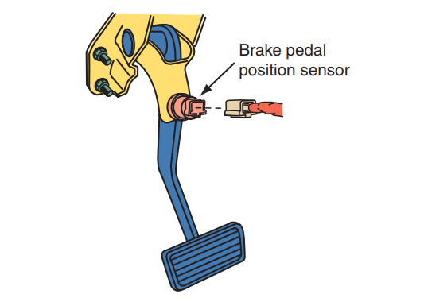
Rear Exterior Lights (4 of 4)
The brake (stop) lights are usually controlled by a stoplight switch or brake pedal position sensor (BPP) that is normally mounted on the brake pedal arm.
Some cars are equipped with a brake or stoplight switch mounted on the master cylinder, which closes when hydraulic pressure increases as the brake pedal is depressed.
Depressing the brake pedal causes the stoplight switch contacts to close.
Current can then flow to the stoplight filament of the rear light assembly.
These stay illuminated until the brake pedal is released.
In addition to the stoplights at the rear of the vehicle, all late-model vehicles have a center high-mounted stoplight (CHMSL).

Slide 36
LED Lights
Some vehicles use neon lamps and/or LEDs for tail, brake, and turn signal lights. LED bulbs illuminate much faster than a standard bulb.
The importance of this time difference is that it gives the driver behind the vehicle an earlier warning to stop.
This early warning can give the approaching driver 19 more feet for stopping when driving at 60 miles per hour.
LEDs have a long operating life and provide a more precise contrast and signal pattern, thus attracting attention much more effectively.
Using the same basic technology as LEDs, laser-lit taillights consume seven times less power than incandescent sources.
These savings are extremely important for electric vehicles.
The light waves of a laser light beam move in the same direction and the light is all the same color.

Slide 37
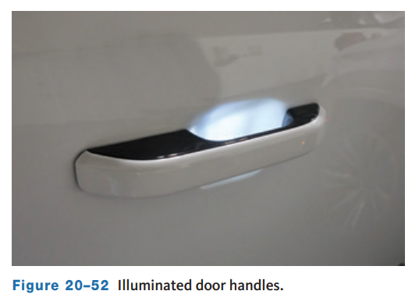
Other Exterior Lights
20.06 Diagnose and service exterior lights. Identify types of interior lights and their purposes.
Many vehicles have additional exterior lights, typically from LEDs, to help illuminate around the outside of the vehicle for safety and looks.
Illuminated door handles have lights that turn on when the keyless entry system is used to lock or unlock the doors or access other parts of the vehicle.
Puddle lights are often located either on the bottom of the outside mirrors or in the bottom of the door trim.

Slide 38
Interior Light Assemblies (1 of 4)
20.06 Diagnose and service exterior lights. Identify types of interior lights and their purposes.
Engine Compartment Light:
  Either a hood switch or a mercury switch can be used to turn on the engine compartment light.
Glove Box Light
  Opening the glove box door closes the glove box light switch contacts and the light comes on
Luggage Compartment Light
  The light is mounted in the underside of the trunk deck lid in the luggage compartment.
Trunk Lid Light
  Lifting the trunk lid causes the light switch to close and the light to come on.
Vanity Light
  Pivoting the sun visor downward and opening the vanity mirror cover causes the vanity light switch contacts to close and the light to come on.

Slide 39
Interior Light Assemblies (2 of 4)
Vehicles may have courtesy lights in the door trim panels, under each side of the instrument panel, above the foot wells, or in the center of the headlining.
Their sole purpose is to allow light inside the vehicle.
The courtesy lights are also turned on by the illuminated entry or keyless entry systems, if the vehicle is equipped with one or both of these.
LEDs are often used for interior lighting and custom colors can be often selected by the driver.
Typically, power is supplied from the fuse block to the courtesy lights. The ground is controlled by the position of the door switch.
The door switches are held in an open position and do not provide for a ground circuit. When the door is opened, a spring pushes the switch closed to ground the circuit, and the courtesy lights rarely give any trouble.
However, if they do not operate, check the fuse, bulb, switch, and wiring. Illuminated entry systems make entry into the vehicle safer by illuminating the door lock cylinder when it is dark so the lock can be easily located.

Slide 40
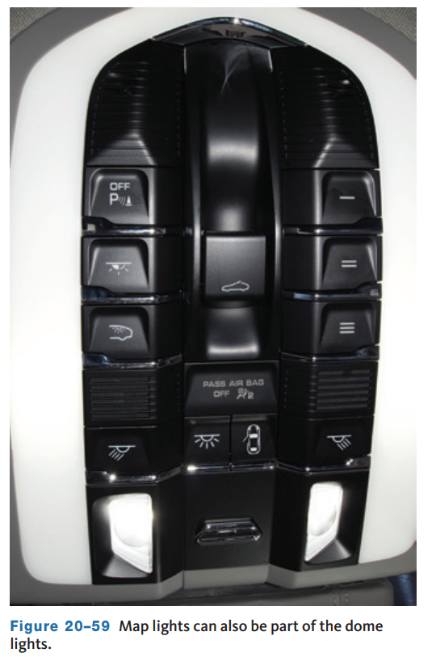
Interior Light Assemblies (3 of 4)
Dome/Map Light
  Map lights are typically located on each side of the dome/map light housing.
  They are operated independently of the dome light by switches located at each map light.
  The dome light is activated by a switch or along with the courtesy lights when the door is opened.

Slide 41
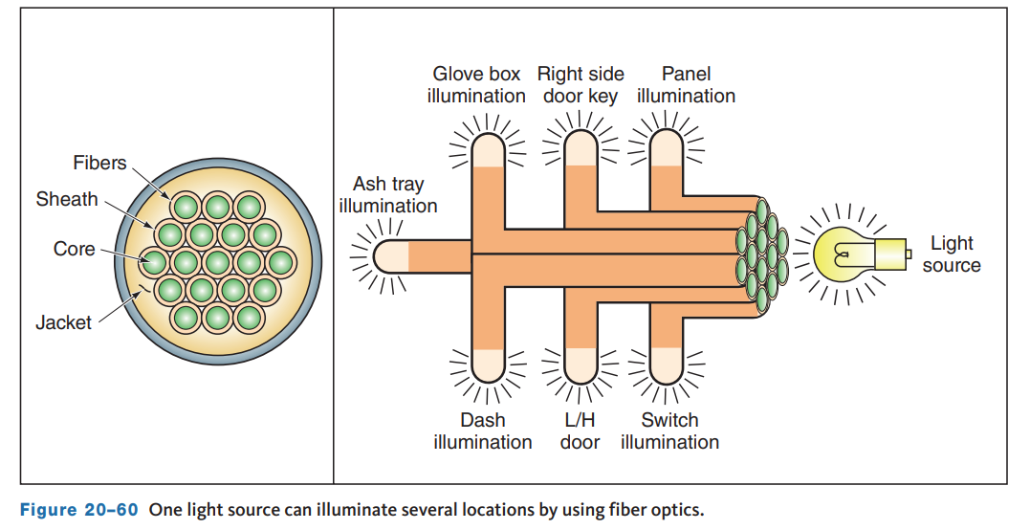
Interior Light Assemblies (4 of 4)
Distributed lighting refers to light present at one source and transmitted through fiber optic “tubes” to one or more other locations.
This technology has been around for quite some time and used to illuminate all instrument panel gauges with a single lamp.
Distributed lighting is typically used to add lighting at places where it might not be practical to have a bulb.

Slide 42
Knowledge Check (2 of 2)
List three types of interior light systems commonly used:

Slide 43
Knowledge Check Answer (2 of 2)
Types of interior light systems commonly used:
  Engine Compartment Light
  Glove Box Light
  Luggage Compartment Light
  Vanity Light
  Dome/Map Light

Slide 44
Chapter Reflection
Please take a moment consider the various types of lighting systems you have learned about in this chapter. Then respond to the following questions in one or two paragraphs. Use 150–200 words in your reflection.
Did you struggle to understand any of the concepts regarding lighting systems? What can you do to better understand?
Considering all you have learned about lighting systems, do you feel prepared to perform this type of work in the shop? What can you do to be sure you are prepared?

